Slide 1
Does recurrence help CORnet-S?
Reproduction report-back
Reproducing Fig. 4 of Kubilius et al. (NeurIPS 2019). The effect did not reproduce.
[Brain-like-object-recognition-with-high-performing-shallow-recurrent-anns-Paper ~ NeurIPS-2019]
Author: Margaret Keitshokile Molefe.
Student Number: 456052
github.com/Tshoki-m/Investigating-the-Effect-of-Recurrent-Processing-on-CORnet-S-Performance
Notes:
Opening, about 20 seconds. I set out to reproduce one claim from the CORnet-S paper: that recurrence matters for ImageNet accuracy. Short version: at my scale it did not reproduce, and I will show exactly how I know.

Slide 2
The claim
Removing recurrence from CORnet-S lowers ImageNet top-1 by about 7 points.
1/1/1 (no recurrence)
2/2/2
4/4/4
-7
-1
0
Change in top-1 versus the 2/4/2 baseline (recurrent steps in V2/V4/IT). Variants trained separately, identical hyperparameters, no seeds or error bars reported.
The paper uses 1.28M images, 1000 classes and 224×224 inputs.
Kubilius et al., NeurIPS 2019 · Fig. 4, row 1 (Sec. 4.3)
Notes:
The claim is Fig. 4, row 1, Section 4.3. The authors trained each variant separately with identical hyperparameters and report the change in ImageNet top-1 relative to the 2/4/2 baseline: minus 7 with no recurrence, minus 1 for 2/2/2, no change with more steps. I read these off the rendered figure; they are rounded integers and the paper reports no seeds. I test only the ImageNet top-1 part, not Brain-Score and not the main-factor wording.

Slide 3
My setup: scaled down
What I ran
What I changed
Kept from the paper
Re-implemented CORnet-S; official weights load with strict key matching
4 variants × 3 seeds = 12 runs, trained from scratch
Paper's optimizer and schedule: SGD, 43 epochs, batch 256
Tiny-ImageNet: 100k images, 200 classes, not ImageNet
64×64 inputs, so a 2×2 final map instead of 7×7
Mixed precision, crop scale 0.35, weight decay 1e-4 assumed
SGD with momentum 0.9, batch 256, learning rate 0.1 divided by 10 every 20 epochs, 43 epochs.
One shared recipe for every variant.
Code written with an AI assistant (Claude); I ran every experiment on Colab.
Notes:
I re-implemented CORnet-S. The architecture mirrors the official code, and the official pretrained weights load with strict key matching. I ran 12 trainings, four variants with three seeds each. Be plain about the scale: Tiny-ImageNet instead of ImageNet, 64 pixel inputs, and a 2 by 2 final feature map instead of 7 by 7. Authorship: the code was written with an AI assistant and I ran every experiment; say what you personally reviewed or changed.

Slide 4
My numbers next to the paper's
V2/V4/IT steps | My top-1 (%) | My change | Paper change
1/1/1 | 48.30 ± 0.76 | -0.01 ± 0.51 | -7
2/2/2 | 48.47 ± 0.47 | +0.17 ± 0.37 | -1
2/4/2 (baseline) | 48.30 ± 0.44 | 0 | 0
4/4/4 | 44.59 ± 0.38 | -3.72 ± 0.33 | 0
Mean ± sd over 3 seeds; change is mean difference ± standard error. Not like for like: different data, resolution and class count.
Notes:
Say the like-for-like caveat first: different data, resolution and class count, so the question is whether direction and rough size survive. Then the numbers: 1/1/1 and 2/2/2 equal the baseline within noise, and 4/4/4 is 3.7 points worse. The paper says minus 7, minus 1 and zero. The plus-minus on the change is a standard error over three seeds, so treat it as rough.

Slide 5
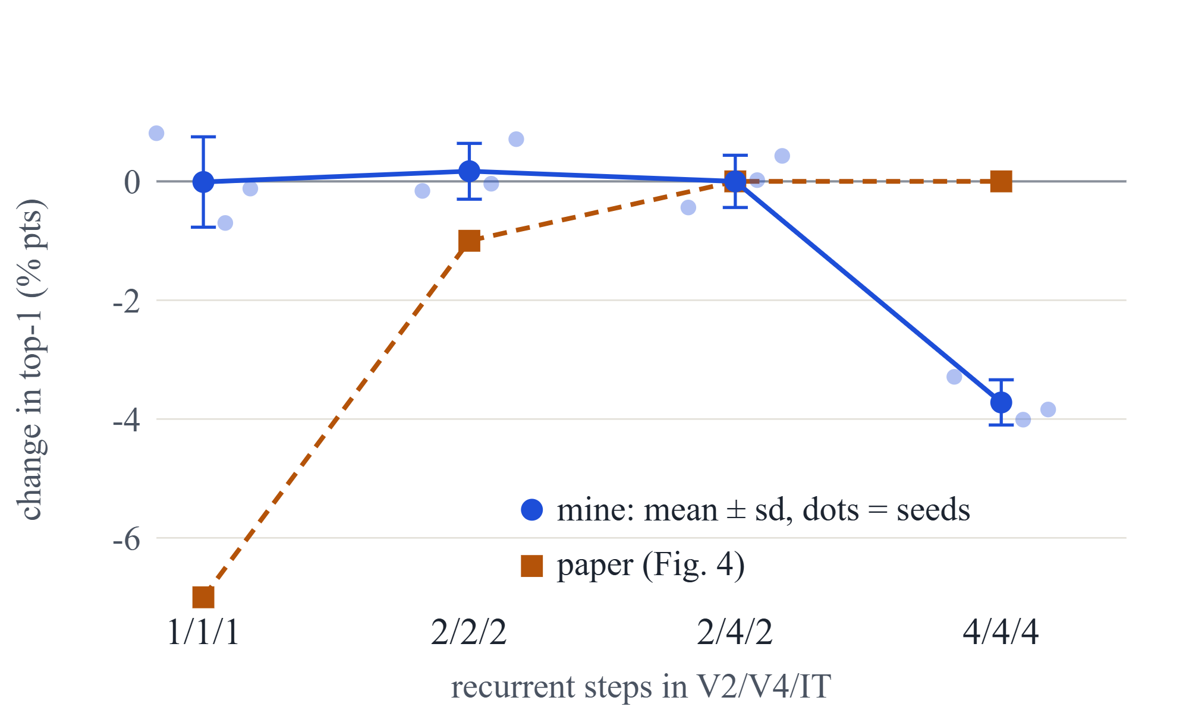
Change in top-1 versus 2/4/2
1/1/1 and 2/2/2 sit on the baseline
4/4/4 drops about 3.7 points
The paper's curve goes the other way
Notes:
Dots are individual seeds, the blue line is the mean with one standard deviation, the orange dashed line is the paper's Fig. 4 values. The blue line stays flat until 4/4/4 and then drops; the orange line is steep at the start and flat at the end. Remember that the comparison is not like for like: my regime is Tiny-ImageNet at 64 pixels.

Slide 6
What did not reproduce
1/1/1: mine -0.01 ± 0.51, paper -7
4/4/4: mine -3.72 ± 0.33, paper 0
No effect, about 14 standard errors from the paper
Clearly worse; every 4/4/4 run is below all others
Cannot explain: why. Untested hypotheses: the 2×2 final map and small data, untuned shared hyperparameters, recurrence confounded with depth.
Tried: 3 seeds and training curves. A no-pool variant (4×4 map) is implemented but not run.
Notes:
This is the main message. No effect of removing recurrence, about 14 standard errors from the paper's minus 7, and 4/4/4 is clearly worse, with every 4/4/4 run below every run of the other configurations. What I cannot explain: why. I have three hypotheses and have tested none of them. What I tried: three seeds and the training curves. The no-pool variant with a 4 by 4 final map is implemented but I did not run it; say that plainly.

Slide 7
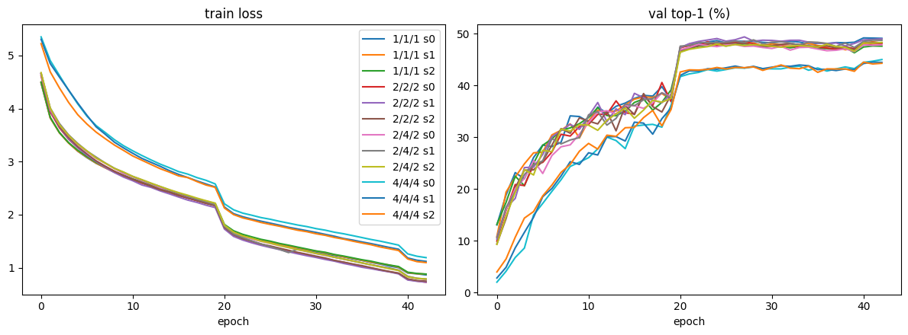
What the training curves show
Twelve runs, three seeds per variant: the seeds cluster, and 4/4/4 starts slower and stays above in training loss.
Notes:
Left panel is training loss, right panel is validation top-1, per epoch. The three seeds of each variant cluster together. 1/1/1, 2/2/2 and 2/4/2 are nearly indistinguishable. 4/4/4 is separate in both panels: higher training loss from epoch 0 and lower validation accuracy throughout, so it is not overfitting, it fits the data worse. The learning rate is divided by 10 at epochs 20 and 40, which causes the jumps. Colours repeat across the twelve lines, so read the clusters, not single lines.

Slide 8
Not in the paper
Seed spread
Training loss
Cost per variant run
sd 0.4 to 0.8
1.14 vs 0.74 to 0.87
55 to 78 min
Seed 0 alone said +1.25 for 1/1/1; seeds 1 and 2 show it was noise
Grows as steps go from 3 to 12, with no accuracy gain
4/4/4 fits the data worse: an optimization problem, not overfitting
Notes:
Three results the paper does not report. First, seed noise: my first seed alone said plus 1.25 for 1/1/1, and seeds 1 and 2 showed it was noise. Second, training loss: 4/4/4 ends near 1.14 against 0.74 to 0.87 for the others, so it fits the data worse and is not overfitting; 2/2/2 and 2/4/2 fit the training data better than 1/1/1 without a validation gain. Third, cost: 55 to 78 minutes per run, growing with the number of steps. Next steps: the no-pool variant, a regime closer to the paper, a matched-depth control.

Slide 9
Backup: the code
Files
One recurrent block
cornet_s.py: CORnet-S, steps per area as an argument
train.py: SGD loop, evaluation, resume, JSON histories
analyze.py: mean ± sd, Welch standard error, figures
reproduce.py: one command for everything
prep_tiny_imagenet.py: download and class folders
check_against_official.py: comparison with the official model
1×1 conv in, then per step: 1×1, 3×3, 1×1
Stride 2 on the first step only; skip connection at every step
Same weights every step, separate BatchNorm per step
The output of step t is the input of step t+1
Notes:
Backup slide for the viva. The model is in cornet_s.py: each area (V2, V4, IT) is a block that repeats its circuit for the given number of steps. The first step downsamples with a stride-2 3x3 convolution and a strided skip; later steps keep the resolution. Convolution weights are shared across steps, BatchNorm is not. train.py trains one variant and saves a JSON history per run; analyze.py aggregates the histories; reproduce.py chains data preparation, training and analysis. Be ready to say which parts you wrote or changed yourself and which the AI assistant wrote.

Slide 10
My Own Take Away
Takeaway
The full sweep on Tiny-ImageNet at 64×64: accuracy falls with total steps (3, 6, 8, 12 steps give 49.1, 48.1, 47.9, 45.0). Final train loss: 0.86, 0.73, 0.78, 1.19.
No benefit of recurrence detected in a small-data, low-resolution setting. Only the 4/4/4 drop is likely real.
Noise: about ±0.5 points per accuracy and ±0.7 per difference on 10,000 validation images.

